Slide 1

Windows 2000 Memory Management
Computing Department,
Lancaster University, UK

Slide 2
Overview
Goals
  Overview of Memory Management
    Virtual memory
    Virtual address translation
    Physical memory
    Page files / page faults
    Working set
    Etc…

Slide 3
Virtual Memory
Virtual address space = logical view
Memory manager translates virtual addresses into physical addresses
Paging transfers some memory contents to disk, freeing physical memory
Virtual Memory
Physical Memory

Slide 4
Virtual Memory – Application’s View
Application always references “virtual addresses”
Not all of an application’s virtual address space is in physical memory at one time
  Application is fooled into thinking that it is
  The rest is kept on disk, and is brought into physical memory as and when it is needed

Slide 5
Mapping Virtual to Physical Pages
Successive page table entries describe
successive virtual pages, pointing to
“scattered” physical pages
Virtual Memory
Virtual Pages
Physical Memory
Page table
entries

Slide 6
Windows 2000 Memory Manager
Provides a 4 GB flat virtual address space
  PAE provides up to 64 GBs…
Exports memory-mapped files
Allows pages to be shared between processes

Slide 7
Virtual Address Space Allocation
Virtual address space is sparse
  Address space contains
    Reserved regions
    Committed regions
    Unused regions
Unit of protection and usage is one page
  Page size within NT and 2000 is up to 64K
    Large value chosen to allow support for future processors with large page sizes
    → No changes required to applications making assumptions about allocation alignment
    X86 uses 4K pages

Slide 8
Kernel Mode vs. User Mode
Operating System Modes
  Kernel Mode (OS)
    Privileged process mode
    Access to system data/hardware
  User Mode (Applications)
    Nonprivileged processor mode
    Limited access to system data/no direct hardware access
Applications separated from the operating system – prevented from modifying critical data
Virtual Address Space (V.A.S.) divided into:
  Process space
  System space
Notes:
When a user-mode program calls a system service, the processor traps the call and then switches the calling thread to kernel mode. When the system service completes, the OS switches the thread context back to user mode and allows the caller to continue.

Slide 9
Virtual Address Space (V.A.S.)
Process space contains:
  The application you are running (.EXE + .DLLs)
  A user-mode stack for each thread
  All static storage defined by the application
User
Accessible
00000000
Unique per
process
7FFFFFFF
80000000
Kernel-mode
accessible
System-
wide
FFFFFFFF

Slide 10
Virtual Address Space (V.A.S.)
System space contains:
  Executive, Kernel and HAL
  Statically-allocated system-wide data cells
  Page tables
  Kernel-mode device drivers
  File system cache
  A kernel-mode stack
  for every thread
  in every
  process
Unique per
process
User
Accessible
00000000
7FFFFFFF
80000000
Kernel-mode
accessible
System-
wide
FFFFFFFF

Slide 11
Windows 9x Virtual Address Space
1 GB region for user-mode shared memory
  Shared memory has same addresses in all processes
  No protection between applications for shared memory
User
Accessible
Unique per
process
Shared, process-
writable
(DLLs,
shared memory,
Win16 apps)
System-
Wide, user
mode
Windows 95
OS
System-
Wide, kernel
mode

Slide 12
Virtual Address Translation
Hardware converts each valid virtual address to a physical address
virtual address
Virtual page number
Byte within page
Page
Directory
Address translation
(hardware)
If page
not valid
Page
fault
Page
Tables
Physical page number
Byte within page
Translation
Lookaside
Buffer
physical address

Slide 13
Physical Memory
Maximum physical memory supported by Windows NT 4.0 is 4 GB for x86, 8 GB for Alpha
Windows 2000 has extended addressing support
  Can address up to 64 GB on an x86 using 36-bit PAE – Physical Address Extension – introduces a “page directory pointer table”
  PAE really is just a stop-gap…
  Maximum supported memory on Windows 2000
    Professional, Server: 4GB
    Advanced Server: 8GB
    Datacenter Server 64GB

Slide 14
Increased Limits in 64-bit Windows 2000
  64-bit Win2000 32-bit Win2000
Virtual memory 16 TB 4 GB
System cache 1 TB 1 GB
Paging file size 512 TB 16 TB
Paged pool 128 GB 470 MB
Non-paged pool 128 GB 256 MB

Slide 15
Page Files
Only used when private memory requirements exceed the amount of physical memory available
Size depends on virtual memory requirements of applications and drivers
  Minimum page file size should be maximum of the normal “virtual memory” usage
    → No pagefile fragmentation
    Hard disk space is cheap
Contiguous page files do help!
  Will be, when created, if space is available
  Or defrag… (Pagedefrag tool)

Slide 16
Page Files (2)
When page file space runs low:
  1. “System running low on virtual memory”
    First time: Before pagefile expansion
    Second time: When committed bytes reaching commit limit
  2. “System out of virtual memory”
    Page files are full

Slide 17
Who is Consuming Pagefile Space?
Process memory leak
  Task Manager, Processes tab, VM size
  Or Perfmon “private bytes”
Paged pool leak
  Could be a result of processes not closing handles
    Task Manager, Processes tab, Handle count

Slide 18
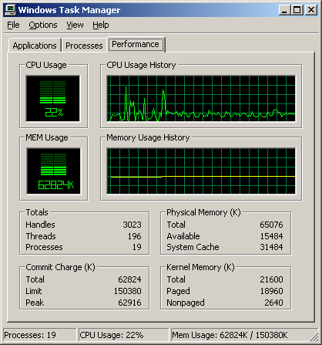
Memory Management Information
Total committed private virtual memory (total of “VM size” + Kernel Memory Paged)
“Commit charge limit” = sum of physical memory available + current total size of paging files
1
1
2
1
2
1
2

Slide 19
Page Faults
A page fault occurs when there is a reference to a page that isn’t mapped to a physical page
The system goes to the appropriate block in the associated file to find the contents of the page:
  Physical page is allocated
  Block is read into physical page
  Page table entry is filled in
  Exception is dismissed
  Processor re-executes the instruction that caused the page fault
The page has now been “faulted into” the process “working set”
Pages are only brought into memory as a result of page faults

Slide 20
Mapping of (Committed) Virtual Address Space to Files
Ranges of virtual address space are mapped to ranges of blocks within disk files
  These are the “backing store” for the virtual address space
Commonly used files are:
  The system paging file
    Used for most writeable data
  Files for read-only applications and sharable data
    Executable program or DLL
It is possible to set-up additional file / virtual address space relationships at runtime
Exceptions to this mapping include the nonpaged pool

Slide 21
Working Set
Working set: All the physical pages “owned” by a process
  All the pages the process can refer to without incurring a page fault
Working set limit: The maximum number of pages the process can own
  When limit is reached, a page must be released for every page that is brought in (working set replacement)
  Default limits on size for each process:
    Mem: small, min WS = 20, max WS = 45
    Mem: medium, min WS = 30, max WS = 145
    Mem: high, min WS = 50, max WS = 345

Slide 22
Working Set (2)
A process always starts with an empty working set
When working set “count” = working set limit, process must give up pages to make room for new pages
Page replacement is a “modified FIFO”
  Windows 2000 on a uniprocessor x86 implements a “least recently accessed” policy

Slide 23
Working Set System Services
Can adjust maximum working set size
  Actually changes the limited within which the system may change your working set
  Limits are “soft”
Can also self-initiate working set trimming
  Minimizing window does this…
  Demo…

Slide 24
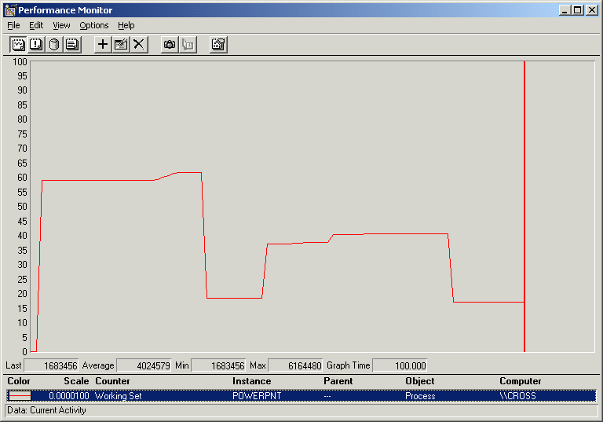
Working Set System Services (2)
Perfmon showing Process / Working Set

Slide 25
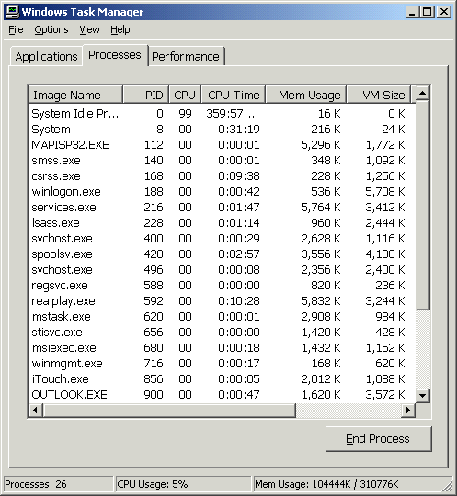
Process Memory Information
“Mem Usage” = physical memory used by process (WS size not WS limit). Note: shared pages are counted in each process
“VM Size” = private (not shared) committed virtual space in processes
“Mem Usage” in status bar in not total of “Mem Usage” column
1
1
2
2
3
3

Slide 26
System Working Set
Just as processes have working sets, Win 2000’s pageable system-space code and data lives in the “system working set”
Made up of 4 components:
  Paged pool
  Pageable code and data in the executive
  Pageable code and data in the kernel-mode drivers, Win32K.sys, graphics drivers etc…
  Global file system data cache
To get physical (resident) size of these with Perfmon, look at: Memory | Pool Paged Resident Bytes, System Code Resident Bytes, System Driver Resident Bytes, System Cache Resident Bytes, Cache bytes

Slide 27
Memory Management Information
“System Cache” really the total physical size of pageable portions of paged pool, NtosKrnl.Exe code and data, drivers code and data and file system cache
“Available” = sum of free, standby, and zero page lists (physical)
1
2
2
1

Slide 28
Accounting for Physical Memory Usage
Process working sets
  Remember that shared resident pages are counted in the process working set of every process
    The total of all of these may be greater than physical memory
Nonpageable system code
  NTOSKNL + drivers
Nonpageable pool
Free, zero and standby page lists
Pageable, but currently resident, system-space memory
Modified, bad page lists

